Slide 1
Introduction to Programming
Lecture 7

Slide 2
Agenda
Structs
Enumerations

Slide 3
Structs

Slide 4
Structs
Structures (also called structs) are a way to group several related variables into one place. Each variable in the structure is known as a member of the structure.
Different than an array where all its elements are of the same datatype, a structure can contain many different data types

Slide 5









Create a structure
To create a structure, use the struct keyword and declare each of its members inside curly braces.
After the declaration, specify the name of the structure variable.
struct { int ID; string name; } s1;
struct Student{ int ID; string name; };
Student s1;
Or

Slide 6
Access Structure Methods
To access members of a structure, use the dot syntax (.):
struct Student{ int ID; string name; };
Student s1; // Assign values to members of the structure s1.ID= 1234; s1.name = “Ahmed Ali"; // Print members of the structure cout<<s1.ID<<endl; cout<<s1.name<<endl;

Slide 7
One Structure in Multiple Variables
Multiple structure variables could be declared separated with commas
struct { int ID; string name; } s1, s2, s3;
struct Student{ int ID; string name; };
Student s1,s2,s3;
Or

Slide 8
Example 1: Car struct
Create a structure called Car where each car has a brand, model, and a year of manufacturing.
Declare more than one car variable.
Give initial values to the structure members.

Slide 9
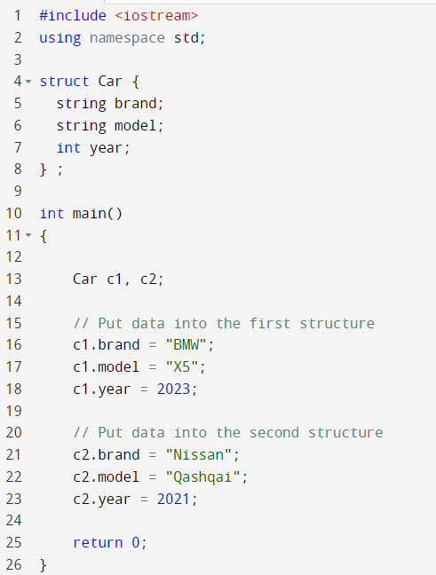
Example 1: Car struct
Global variable

Slide 10
Example 2: Car struct continue
Define a function that gets the details of each from the user, and returns a car variable.
Car getInfo ()
Define a function that given the car struct variable as a parameter, it prints the structure members.
void printCar (Car c)

Slide 11
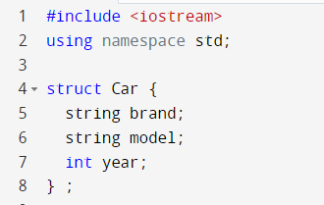
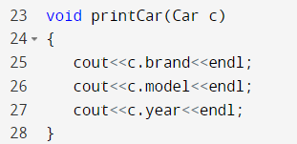
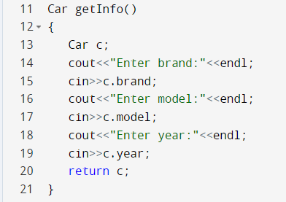
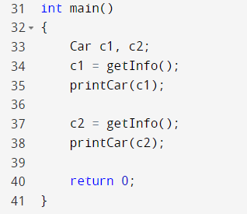
Example 2: Car struct continue

Slide 12
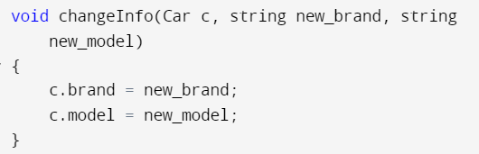
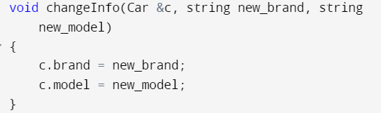
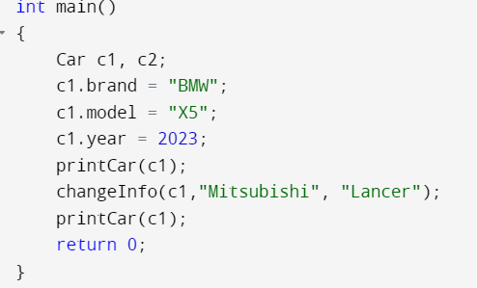




Passing a struct to a function
Write a function to change the model and brand of a car.
Passing by reference
Passing by value

Slide 13
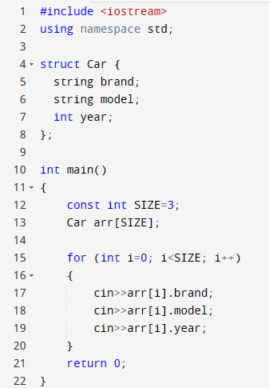

Example 3 : Array of struct
Extend example 2 to create an array of car structs and let the user enter the information of all arrays.
i=0
brand
model
year

Slide 14
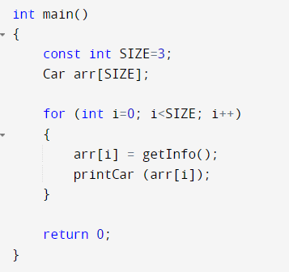

Example 3 : Array of struct
Extend example 2 to create an array of car structs and let the user enter the information of all arrays and print the array using the function in slide 11.

Slide 15
Enumeration

Slide 16




Enumeration
Enum, which is also known as enumeration, is a user-defined data type that enables you to create a new data type that has a fixed range of possible values, and the variable can select one value from the set of values.
Enums or enumerations are generally used when you expect the variable to select one value from the possible set of values.
An enumeration is a user-defined data type that consists of integral constants. To define an enumeration, the keyword enum is used.
enum icecream
{ vanilla,
strawberry,
chocolate,
mango,
oreo
};
icecream x1,x2,x3;
vanilla is value 0
strawberry is value 1
chocolate is value 2
mango is value 3
oreo is value 4

Slide 17
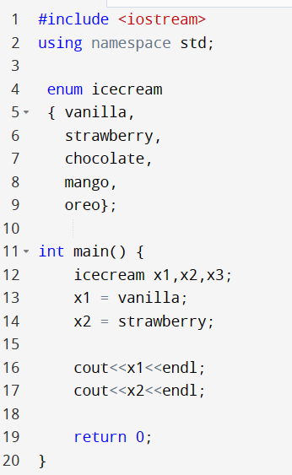
Example 4: Icecream enum
0
1

Slide 18
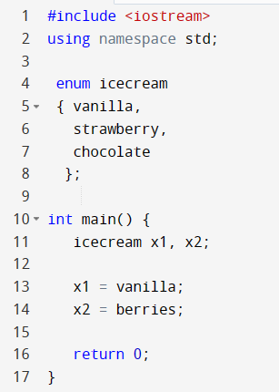

Example 4: Icecream enum
Error

Slide 19
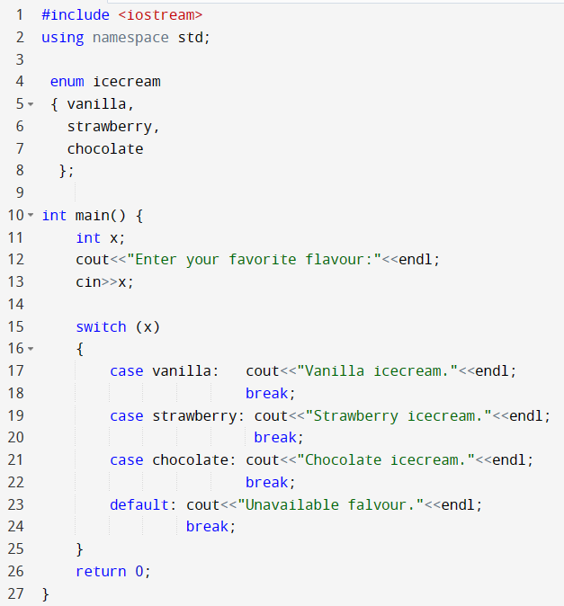
Example 4: Icecream enum continued

Slide 20
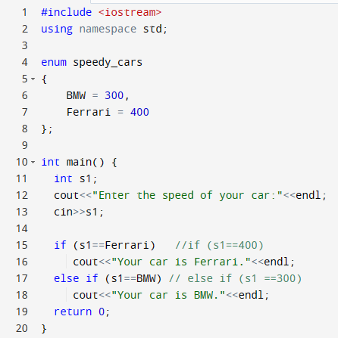
Example 5: Speedy cars enum
We can change the initial value instead of 0

Slide 21

Test your understanding
Problem one:
Declare a struct called Employee that has members ID, name, and salary.
Declare two variables of type Employee, and give the members initial values.
Problem two:
Declare an enumeration called season that has 4 values (spring, summer, autumn, and winter)
Declare a variable called s1 of type season, give it an initial value, and print it out.

Slide 22
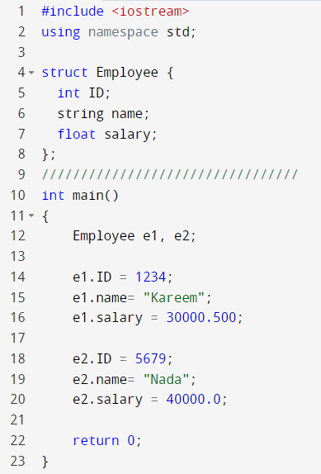
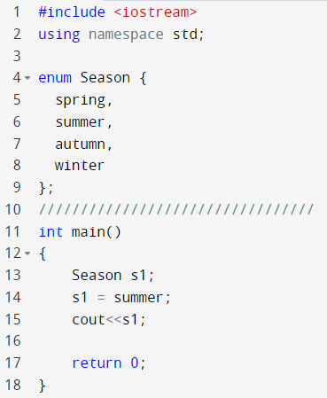

Test your understanding
Problem one Solution:
Problem two Solution:

Slide 23

Thank You

